Slide 1
527 Data Analytics
Final Project – Group3 Apple Inc.
Shravan Shankar Polisetty Ezhilarasi Ravichander Abdul Bari Mohammed Shushmitha Anthay Suthakaran Saahil Sofat

Slide 2
Contents
Table of Contents
About Apple Inc.
DEF 14A filings
Salary Trend Analysis – Apple vs IBM (Comparison )
Stock and Option Awards Analysis
Stock Trading Activity Analysis
Introduction to Text Analysis
Word Frequency Distribution
Key Event Indicators (KEI’s)
Word Correlation Findings – Apple vs IBM (Word Plot)
Conclusions and Future

Slide 3
About Apple Inc.
Apple Inc. is an American multinational technology company headquartered
in Cupertino, California, that designs, develops, and sells consumer
electronics, computer software, and online services.
Apple was founded by Steve Jobs, Steve Wozniak and Ronald Wayne
on April 1, 1976 to develop and sell personal computers.
It was incorporated as Apple Computer, Inc. on January 3, 1977, and
was renamed as Apple Inc. on January 9, 2007, to reflect its shifted focus
toward consumer electronics.
Some of their products are as follows:
iPhone smartphone
iPad tablet computer
Mac personal computer
iPod portable media player
Apple Watch smartwatch.
Apple is the world's largest information technology company by revenue, the world's largest technology company by total assets, and the world's second-largest mobile phone manufacturer.

Slide 4
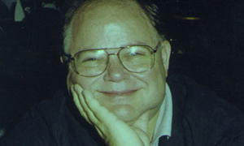
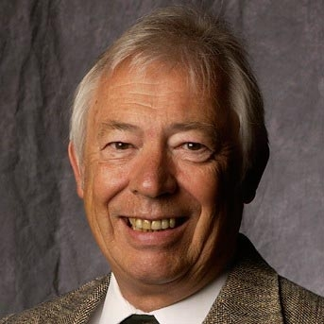
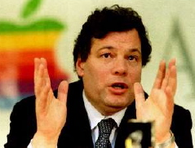
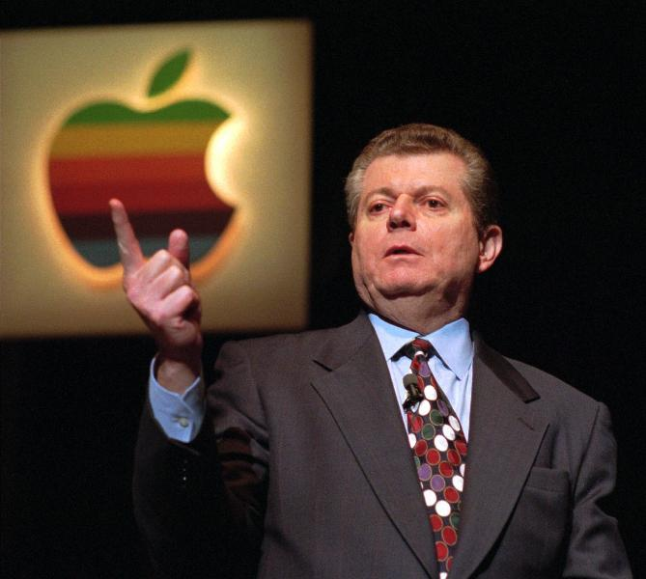
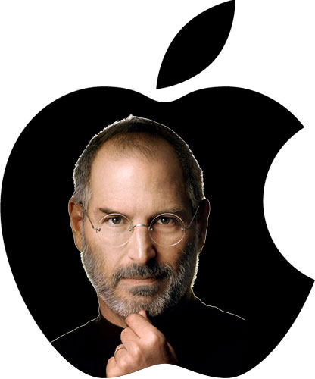
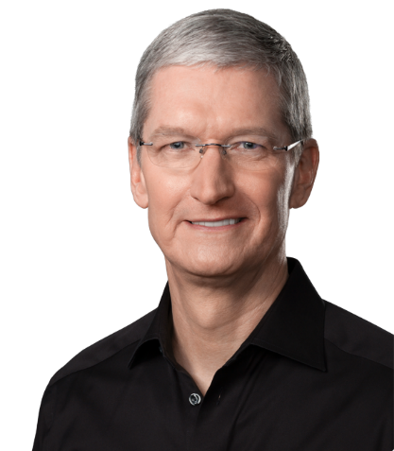
List of CEO’s
1977 to 1981 – Michael Scott
1981 to 1983 – Mike Markkula
1983 to 1993 – John Sculley
1993 to 1996 – Michael Spindler
1996 to 1997 – Gil Amelio
1997 to 2011– Steve Jobs
2011 – Present : Tim Cook

Slide 5
About DEF 14A Filing
A proxy statement is a statement required of a firm when soliciting shareholder votes.
This statement is filed in advance of the annual meeting.
The firm needs to file a proxy statement, otherwise known as a Form DEF 14A (Definitive Proxy Statement), with the U.S. Securities and Exchange Commission. This statement is useful in assessing how management is paid and potential conflict-of-interest issues with auditors.
The statement includes:
Voting procedure and information.
Background information about the company's nominated directors including relevant history in the company or industry, positions on other corporate boards, and potential conflicts in interest.
Board compensation.
Executive compensation, including salary, bonus, non-equity compensation, stock awards, options, and deferred compensation. Also, information is included about perks such as personal use of company aircraft, travel, and tax gross-ups. Many companies will also include pre-determined payout packages for if an executive leaves the company.
Who is on the audit committee, as well as a breakdown of audit and non-audit fees paid to the auditor.
Apple Inc. has 22 DEF 14 A filings on https://www.sec.gov/ site

Slide 6
Graph – Salary Trend (Apple Inc.)
Notes:
The CEO salary trend shown in the graph displays each of the 4 CEO's salary for each year.
The 2 main observations from this graph are:
1. Steven P. Jobs accepted only $1/year as salary while he was the CEO of Apple. This is interesting because, he probably got more compensations in the form of stock awards and option awards. Also having taken only $1 as salary, he probably paid less or no income tax.
2. In 1996 the salary of the then CEO Michael H. Spindler had a huge dip. On further investigation of the stock price around the same time, it was observed that Apple was not doing too well and had a low of $23. This gives reasons to believe that management was not happy with the CEO and wanted to reduce his salary, and also have him replaced. This can be infered with the change in CEO that happened the same year.

Slide 7
Graph – Salary Trend (IBM)
There is a drop in the salary for every new CEO that is appointed. It can be seen here in the CEO salary trend for IBM.
Notes:
This slide contains the CEO salary compensation for IBM. This analysis was done to find comparisons with Apple's trend of Compensations.
The only distinct similarity is that when a new CEO is appointed, their salaries start low (lower than the last salary offered to the previous CEO), and then have a steady climb.
This gives reason to believe that since they are new to the role of CEO they are given lesser starting salaries.

Slide 8
Graph - Stock Awards
Notes:
This slide shows us the stock awards that were granted to each of the CEOs.
It can be seen that in the year 2003 Jobs was granted a lot of stock awards. On further investigation of the stock price that year, Apple's stock was at a staggering low of $15. This gives reason to believe that Jobs found this to be an opportunity to buy a lot of stocks.

Slide 9
Graph – Option Awards
Year 1996 in x-Axis is repeated because it includes the data for Michael H.Spindler, former president and CEO and Gilbert F.Amelio ,Chairman of the Board and CEO
Notes:
This is a slide that shows the option awards that were granted to the CEOs. Here it can be seen that in the year 1996 the then CEO Gilbert F. Amelio got a lot of option awards. We know that the stock price that year was at a low of $18. This gives reason to believe that this was an opportunity to receive a lot of option awards.

Slide 10
Cumulative Analysis
Salary Trend Analysis
Steven P. Jobs – $1 salary as CEO.
We see that the salary of the CEO had a major fall in 1996 followed by the change in the then CEO; Michael H.Spindler to Gilbert F. Amelio. These events can be compared with the fall in stock price in that year(1996), where it reached a low of $23 as seen in the Stock Trade Activity.
Stock Awards Trend Analysis
In the year 2003 Steven P. Jobs was awarded the maximum amount of vested stocks, through his reign as the CEO. The stock price in 2003 was cited at a low of $15 (seen in the Stock Trade Activity), which would have been an opportunity for jobs to purchase maximum market shares.
Option Awards Trend Analysis
In the year 1996, the then CEO, Gilbert F. Amelio was awarded a huge amount of stock options. The stock price in 1996 was cited at a low of $18(seen in the Stock Trade Activity), which would have been an opportunity for him to purchase maximum option awards.

Slide 11
Stock Trading Activity Analysis

Slide 12
Stock Trading Activity Analysis (Cont.)
Intended to find trends in stock price, by recording stock activity, a few days before and after DEF 14a filing.
For instance a set of data from an earlier year(2003), and a recent years data(2014) is considered.
The stock price for the year 2003 has minor fluctuation which almost remained $14 throughout.
Whereas there is a plunge in the stock price for 2014 where it goes down from $540 to $532 and goes up to $557.
No recognizable pattern was observed among the stock trading activity and DEF 14a filing dates. We believe that this is because the stock price depends other factors and not the filing date.

Slide 13
Stock Trading Activity Analysis (Cont.)
An interesting fact which was identified during the process of finding trends in Stock Trading Activity is stock split.
Apple was a trend setter who coined the term stock split in April 2014. During this process the stocks are split into 1:7 ratio and the stock prices plunge to a much lower price.
It was a strategy to lure more investors and thereby gain a huge profit.

Slide 14
Intro - Text Analytics
We identified the Q&A Section from the DEF 14A filing over the years (General Information)
Saved these sections to help form a Corpus
Formed a Corpus of these sections using the “TM” package.
Cleaned the Corpus
To Lower Case
Remove Punctuation
Remove Numbers
Remove Default & customized list of stop words. (Ex- the, most, here…)
“GSUB” to remove any unwanted signs and unwanted data
Remove Sparse Terms and Stemming (Optional)
Created a Document Term Matrix
Used “FindFreqTerms” function to find most frequent terms & their counts in the corpus
Understood PATTERNS from these words which helped to make sense of the data.
Notes:
In this slide, we discuss about the text analysis that have been performed on the DEF 14A filings of Apple Inc., on their Q&A Section.
Since we have used R statistical programming language to perform this analysis, the package used in it was the "TM" (text mining) package, to create and clean the corpus and also to create a Document Term Matrix.
The "findFreqTerms" method was used on the Document Term Matrix, to identify the most frequent terms in the Q&A section through the years, to make some sense out of the data by identifying some patterns.

Slide 15
Table - Word Frequency Distribution
findFreqTerms(dtm[dtm$dimnames$Docs==“Document Name”],2,100)
Year | Frequency
 | 2009 | 2010 | 2011 | 2012 | 2013 | 2014 | 2015 | 2016
annual | 58 | 50 | 52 | 50 | 56 | 66 | 61 | 63
companys | 55 | 63 | 54 | 52 | 68 | 89 | 67 | 60
shareholders | 53 | 46 | 45 | 50 | 50 | 66 | 52 | 54
meeting | 49 | 41 | 41 | 38 | 43 | 54 | 46 | 49
shares | 31 | 35 | 34 | 34 | 37 | 49 | 46 | 52
materials | 31 | 31 | 31 | 30 | 30 | 29 | 31 | 26
proposals | 27 | 33 | 29 | 31 | 19 | 61 | 15 | 14
voting | 20 | 18 | 20 | 20 | 26 | 42 | 33 | 33
notice | 19 | 19 | 18 | 18 | 19 | 19 | 21 | 21
Notes:
In this slide, we give a tabular representation of the most frequent terms that have occurred throughout the years in Apple's DEF 14A Filings, using the "findFreqTerms" method.
In this table, the horizontal titles specify the years, the vertical titles are the terms itself and the numeric values indicate the frequency of each term over the years.

Slide 16
Graph - Word Frequency Distribution
Notes:
In this slide, we have given a graphical representation of the most frequent word distribution.
On the x-axis we have the terms, y-axis we have frequencies, and the bars indicate the number of times the word has occurred. Different colors in each bar indicate different years whose legends are specified in the bottom section of the graph.
In this graph, we see annual, company’s, shareholders, meeting and shares are the top 5 most frequent terms, followed by materials, proposals and meeting.
The KEIs that we have identified comes in the next section.

Slide 17
Key Event Indicators
KEI (Frequently Occurring Words):
“annual”, “meeting”, “shares”, “material”, “shareholder”, “voting”, “proposal” and “notice” occur in all filings.
These words can be used for PATTERN Matching to identify filings for Apple Inc..
KEI (Flag Words):
“directors”, “election”, “majority” occur most frequently in the years 2013 and 2014.
Questions include “how to vote?”, “When to vote ?”, “deadlines for voting ?” .
Election was to be held for new board of directors which explains the high usage.
“request” occurs mostly in 2009, 2010, 2011, 2012.
Mostly used in the context of “on request for the printed copy of the proxy document”.
There was decrease in Volume of requests for proxy documents in the following years.
Notes:
There are two KEI's
1) Firstly, frequently Occurring Words, i.e. words like “annual”, “meeting”, “shares”, “material”, “shareholder”, “voting”, “proposal” and “notice” occur in all filings. These words can be seen as a pattern and those patterns helps us to identify Apple’s filing among many filings.
2) Secondly, flag words i.e. words like “directors”, “election”, “majority” occurs most frequently only in years 2013 and 2014.
On our analysis we observe that these words are tied to the question like how to vote?”, “When to vote ?”, “deadlines for voting ?” which are related to election, hence the high usage of these words shows that there was an election for new board of directors.
In future, if these words appear in the filings with respective to same context, then we can predict that there may be an upcoming election for new board of directors.
Similarly for the word request, this word occurs mostly in 2009, 2010, 2011, 2012 years with respect to the context of “on request for the printed copy of the proxy document”. And in the following years we observe that there was decrease in Volume of requests for proxy documents which explains that the action was taken care of.

Slide 18
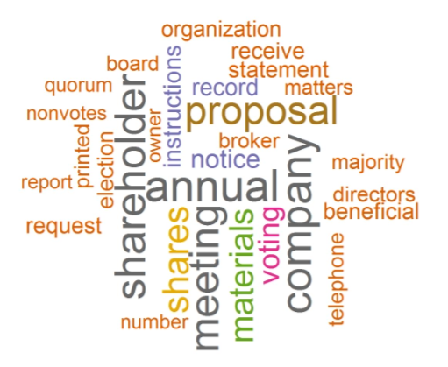
Word Cloud
This word cloud is formed by using a corpus which consists of Q&A sections from multiple DEF -14A filings.
It displays only the most frequently occurring words from the corpus.
18
Notes:
This image contains the word cloud formed using corpus which consists of Q&A sections from multiple DEF 14A filings.
The words are differentiated using different font size and color. Bigger the font size more frequent that term is and vice versa.

Slide 19
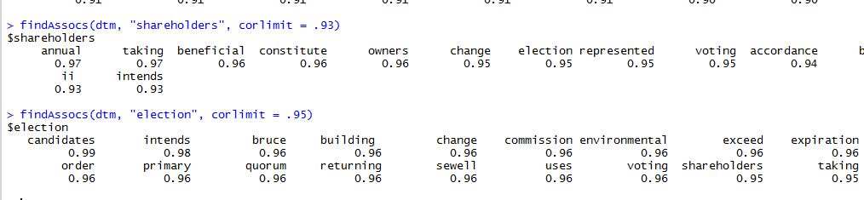
Word Correlations Findings
Used FindAssocs() function and found the word “Shareholders” has a 0.93 relation coefficient with “annual”, ”election”, ”voting”.
Also the vice-versa holds true. “Election” has a 0.95 relation coefficient with “shareholders”.(seen below)
Signifies that words are used in similar context.
Multiple Correlations can be found depending on the objectives.
findAssocs(dtm, “shareholders”, corlimit=0.93)
Notes:
Used the FindAssocs() function to find the relationship of a word with others.
We find that the word "Shareholders" has a 93% correlation with "annual", "election" and "voting"
The vice versa i.e. election also has a 95% correlation with the word "shareholders".
This proves that these words are almost always used together.
Other observations like this can be found depending on our objectives.

Slide 20
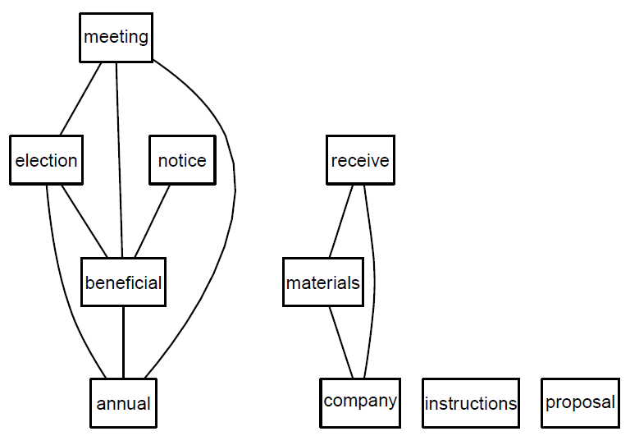
Correlation Plot (Rgraphviz)
plot(dtm,terms=findFreqTerms(dtm, lowfreq=100)[1:8],corThreshold=0.7)
Fig1: Word pattern -Apple, Inc
Notes:
Used the Rgraphviz Package to plot the relationship of the top 8 words among themselves.
We can input a Document Term Matrix, along with the frequency and top frequent words parameters.
The Correlation threshold is at 70%

Slide 21
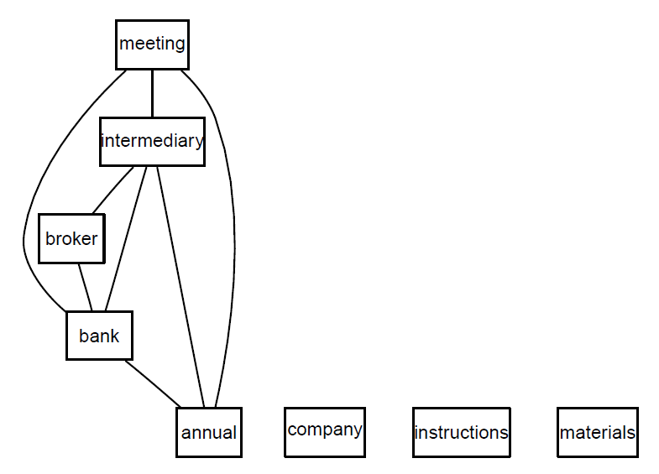
Correlation Plot – IBM
Frequent words
Intermediary
Broker
Bank
Shown in Fig 1
Words which form a pattern for IBM.
Common words across companies.
Company
Instructions
Materials....
Fig 1:Word Pattern - IBM
This shows the
Presence of similar words across companies, referring to similar questions.
Notes:
This is a similar plot as in the previous slide for IBM.
We see that some of the words are common to both the companies as they both are from the DEF 14A filings.
Other words like "Broker", "Bank" appear only in IBM's filings.
The similar words are a cause of similar questions in both the filings.

Slide 22
Conclusion & Future Uses
Automated the Compensation data from the SEC site, which reduces time and effort.
This Automation can be applied when gathering data, for different requirements.
Understood the CEO compensation details over the history of the company with a click of a button.
Text Analysis also helped understand and make sense of the data without going through it.
Identified word patterns, understood their trends and found possible reasons for it.
Other Uses -
Brand analysis
Marketing analysis
Customer reaction reviews
Used for Intelligence gathering (avoid any terror attacks)

